Slide 1
Cardiotocographic Data
Farid Laib, Jimmy Gozal, Allison Windsor, Sergio Salas

Slide 2
Predicting Fetal Acidosis
Acidosis: increased acidity in the blood and other body tissue.
Cardiotocography (CTG): Recording of fetal heartbeat and the uterine contractions.
Models used: Logistic Regression, KNN, Classification Tree
Notes:
Sleep was also recorded

Slide 3
CTG Dataset
2126 Rows, 40 Variables
16 Categorical, 24 Numerical
No missing values, No outliers, No duplicates
352 Patients
Notes:
ASTV, mSTV

Slide 4
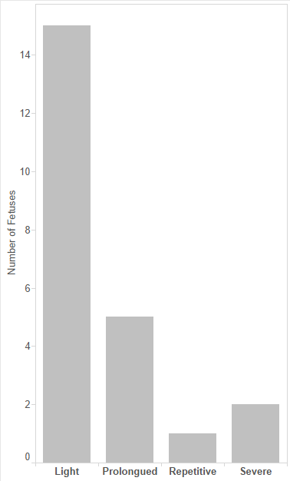
CTG Dataset
Fetuses with Heart Rate Decelerations
18 variables were Calculations
Other variables measured sleep patterns, fetal movement…

Slide 5
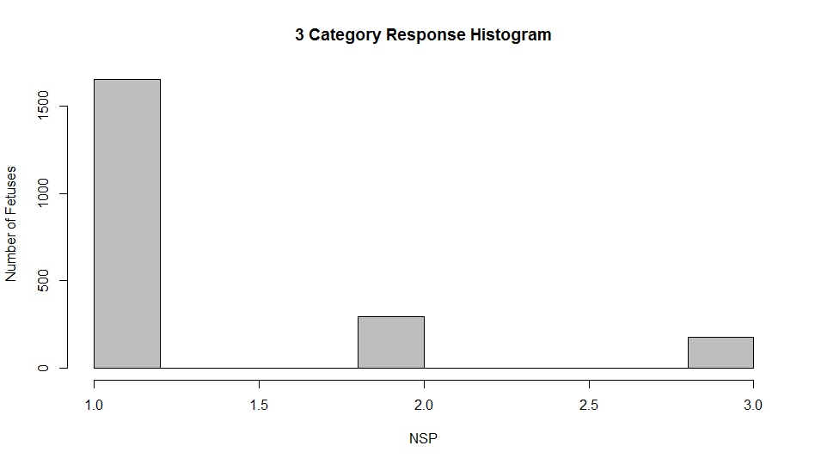
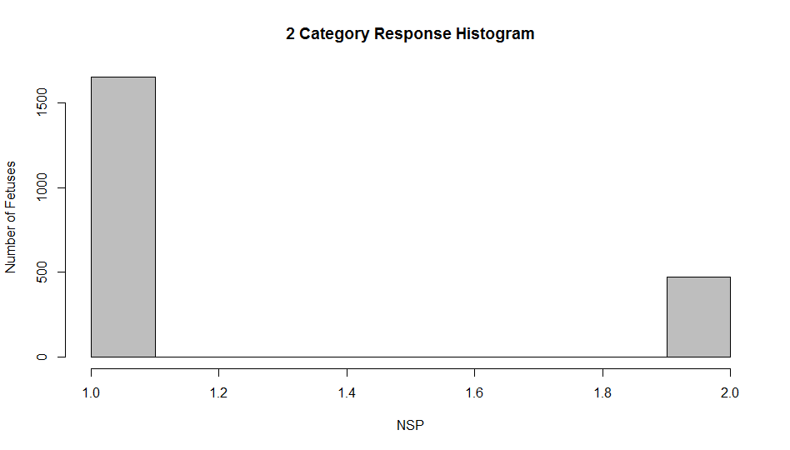
CTG Dataset - Adjustments
2 Sets of Responses:
Normal, Suspect, Pathologic
Normal, Abnormal

Slide 6
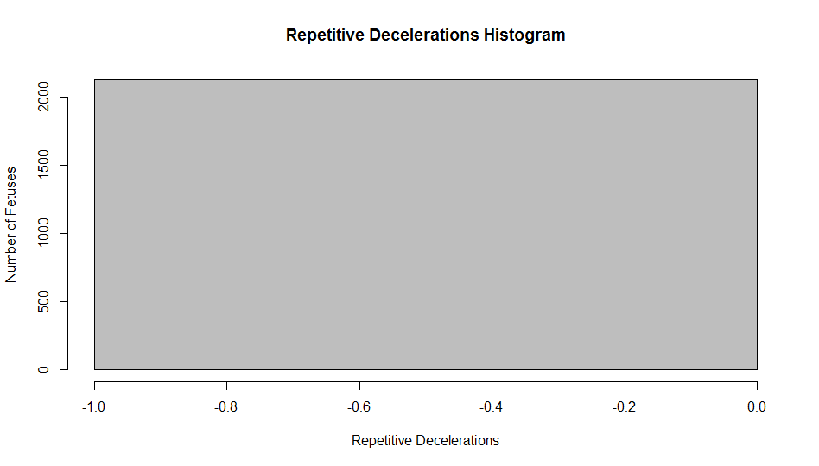
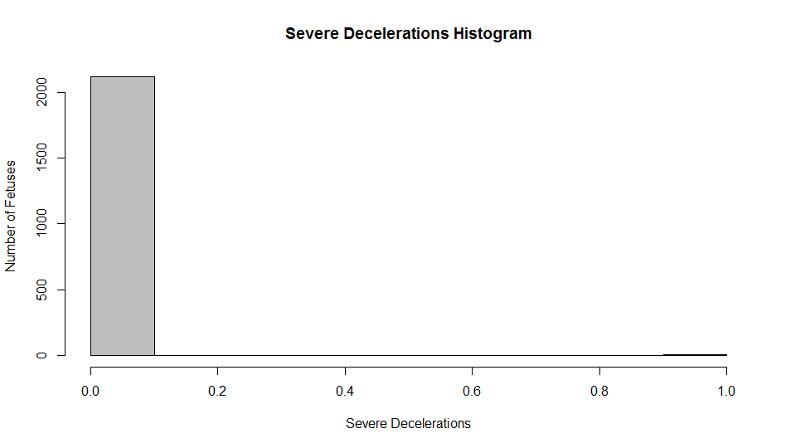
CTG Dataset - Adjustments
Nulling of Variables due to
Redundancy
High % of 0s
Insignificance

Slide 7
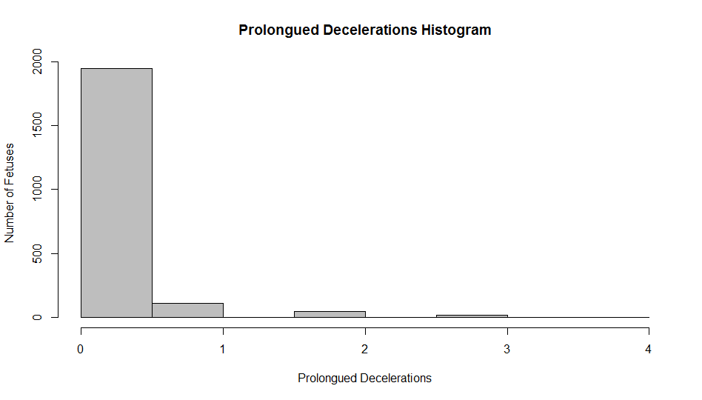
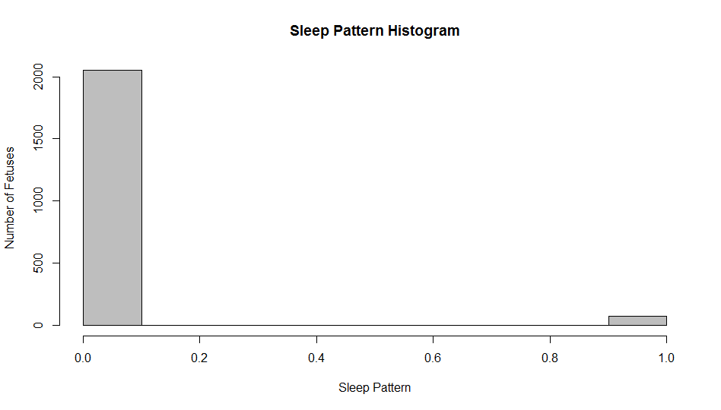
CTG Dataset - Exceptions
Some variables which surprisingly contributed to models
Logistic Model 13 variables; KNN and Classification Tree 25 Variables.
Notes:
Disturbed sleep pattern 1
Regular sleep pattern 0

Slide 8
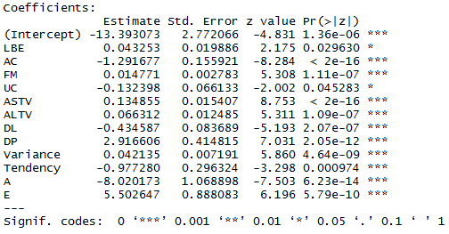
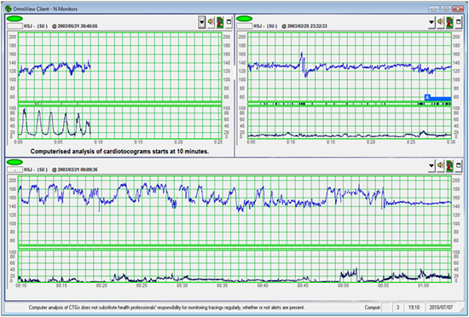
LOGISTIC MODEL
Number of observations: 2126
Number of variables: 13
Cut-off = 0.5
Summary of the fitted model
Omniview-SisPorto 3.0
Notes:
FM = Fetal movement . The American Congress of Obstetricians and Gynecologists (ACOG) recommends that you time how long it takes you to feel 10 kicks, flutters, swishes, or rolls. Ideally, you want to feel at least 10 movements within 2 hours. You will likely feel 10 movements in less time than that.

Slide 9
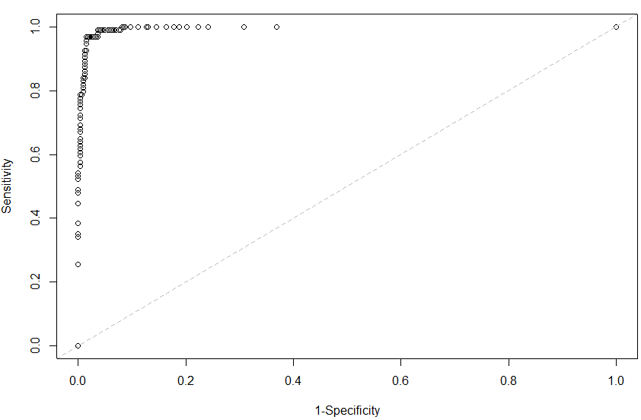
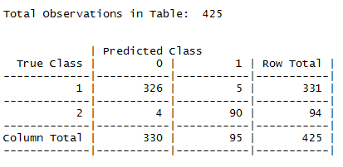

LOGISTIC MODEL (Continued)
$Specificity=\frac{326}{331}=0.98$
$Sensitivity=\frac{90}{94}=0.96$
ROC Plot
Confusion Matrix Table
Interpretations
For example, we see that the parameter estimate corresponding to the fetal movement (FM) is statistically
significant and equals 0.014. That means, that when holding all the predictors other than FM constant
per 1 unit increase in FM the odds that the fetus is in a normal state changes by a factor of e^{0.014} = 1.014

Slide 10
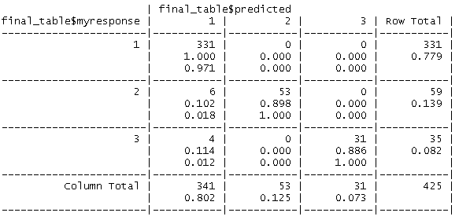
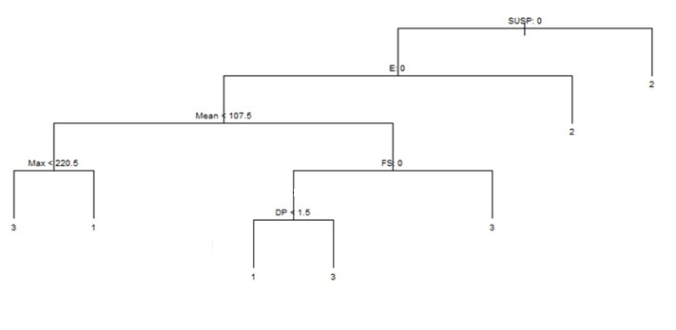
CART with 3 categories
Normal: 100%
Suspect: 90%
Pathologic: 89%

Slide 11
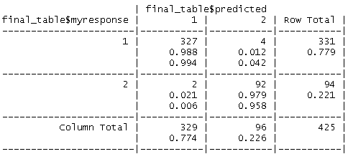
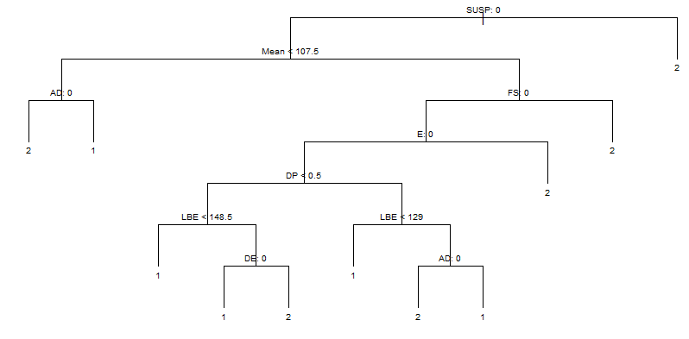
CART with 2 categories
Normal: 99%
Abnormal: 98%

Slide 12
KNN
Excluded 15 variables:
Categorical Variables
Exploratory Analysis
K=1
The amount of information used to classify each observation was minimal
99.3% Classification Rate: 3 Classifications
99.53% Classification Rate: 2 Classifications
Important to have an extremely high classification rate

Slide 13
Classification Matrix for 3 Variables
True Class | 1 | 2 | 3 | Row Total
1 | 330 | 1 | 0 | 331
2 | 1 | 58 | 0 | 59
3 | 1 | 0 | 34 | 35
Column Total | 333 | 62 | 30 | 425
Misclassification Rate: 0.7%
Normal: 99.7%
Suspect: 98.3%
Pathological: 97%

Slide 14
KNN for 3 Categories
KNN is a great model for determining the acid as Normal (1), Suspect (2), or Pathologic (3).
2% of the observations were classified as Normal when they were in fact, not normal
Not able to mathematically deduce why the variables used were so significant
Many integer variables had only 2 values (0 and 1) which may have skewed model

Slide 15
KNN for 2 Categories
True Class | 1 | 2 | Row Total
1 | 330 | 1 | 331
2 | 1 | 93 | 94
Column Total | 331 | 94 | 425
Misclassification rate: .47%
Normal: 99.7%
Abnormal: 98.9%

Slide 16
2 vs. 3 Categories
3 categories for knowing the severity of prognosis
2 categories for wanting a higher overall classification rate

Slide 17
Conclusions
3 Classifications
Model | Normal | Suspect | Pathologic
Clas. Tree | 100 | 90 | 89
KNN | 99.7 | 98.3 | 97
2 Classifications
Model | Normal | Abnormal
Logistic | 98 | 96
Clas. Tree | 99 | 98
KNN | 99.7 | 99

